Slide 1
Fertilizer Recommendation System For Disease Prediction
Prepared by: Guided by:
Gurumoorthy.J Mabel Nirmala
Praveen Joseph Ratniah.E
Manoj Kumar
Barath Kumar

Slide 2
Abstract
Agriculture is the most important sector in today’s life. Most plants are affected by a wide variety of bacterial and fungal diseases.
Diseases on plants placed a major constraint on the production and a major threat to food security. Hence, early and accurate identification of plant diseases is essential to ensure high quantity and best quality
In recent years, the number of diseases on plants and the degree of harm caused has increased due to the variation in pathogen varieties, changes in cultivation methods, and inadequate plant protection techniques

Slide 3
An automated system is introduced to identify different diseases on plants by checking the symptoms shown on the leaves of the plant.
Deep learning techniques are identify the diseases and suggest the precautions that can be taken for those diseases.

Slide 4
Problem Identification
The Majority of the problem lies with the inefficient system used to find the right type of fertilizer.
If the wrong fertilizer is used the crops would not yield the required amount of produce.
The the inefficient fertilizer will not combat the new diseases that are spreading
This Project seeks to combat this problem by recommending the right fertilizer to be used by just uploading the image of the crop.

Slide 5
Existing System
The Current system used to find the correct fertilizer is to do research on the soil present, the crop to be grown, and present diseases that are spreading in crops.
Or by asking more experienced farmers for suggestions but this also gives varying options.
This system takes a lot of time and might not yield the best results.

Slide 6
Proposed System
A Digital Camera or similar devices are used to images of different types, and then those are used to identify the affected area in the crop.
Then various types of image-processing techniques are applied to them to identify the Disease.
The algorithm then clarifies the crop as affected or normal based on the features like color, shape, texture.
It then recommends the fertilizer based on the severity level.
Admin can store fertilizers based on disease categorization with severity level

Slide 7
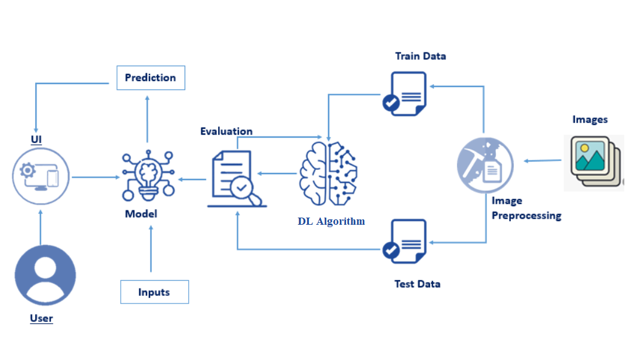
Technical Architecture:

Slide 8
Project Flow
Download the dataset.
Classify the dataset into train and test sets.
Add the neural network layers.
Load the trained images and fit the model.
Test the model.
Save the model and its dependencies.
Build a Web application using a flask that integrates with the model built.

Slide 9
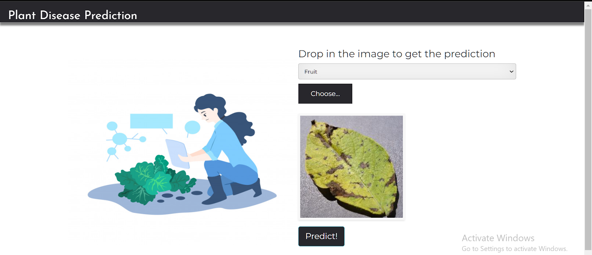
Output

Slide 10
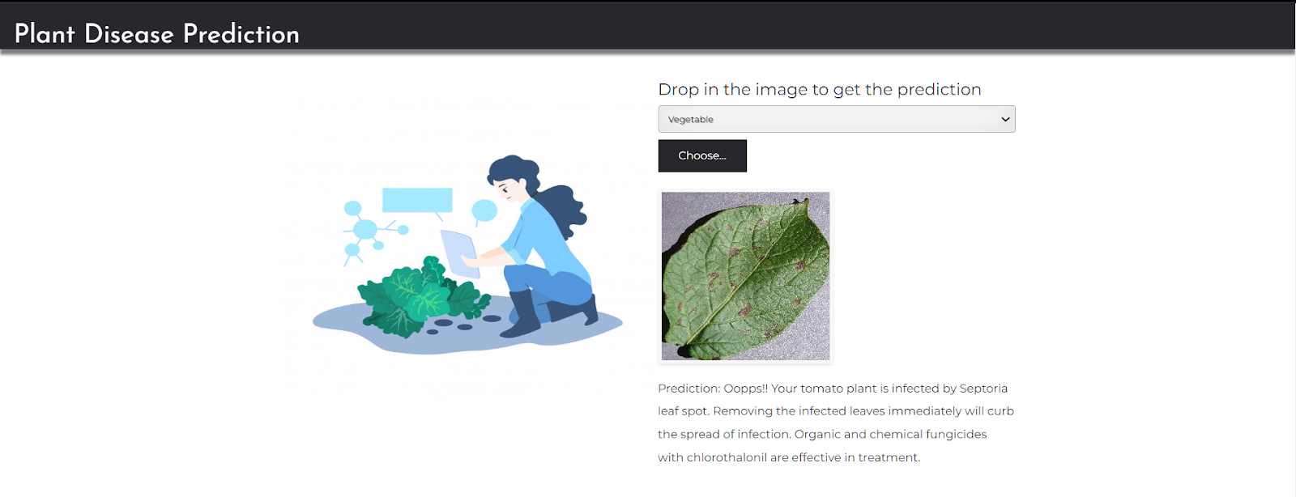

Slide 11
Thank you
Gurumoorthy.J
Praveen Joseph Ratniah.E
Manoj Kumar
Barath Kumar

